Slide 1


Slide 2
3
Chapter
Basic Hand Tools

Slide 3
Objectives
After studying this chapter, you will be able to:
Identify common automotive hand tools.
List safety rules for hand tools.
Select the right tool for a given job.
Maintain and store tools properly.
Use hand tools safely.
Explain why insulated tools must be used when servicing electric drive trains.
Correctly answer ASE certification test questions referring to hand tools.

Slide 4
Tool Rules
Purchase quality tools
Keep tools organized
Keep tools clean
Use right tool for job

Slide 5
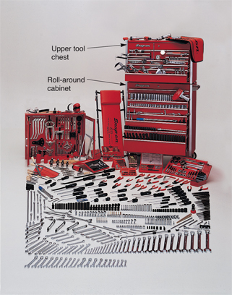
Tool Storage
Toolbox
  Stores and protects tools not in use
  Three basic parts
    Large roll-around cabinet
    Upper tool chest
    Small carrying tray
(Snap-on Tool Corp.)

Slide 6
Toolbox Organization
Keep related tools in same drawer
Do not keep small delicate tools with large heavy ones
Tool holders
  Help organize small tools
  Provide portability

Slide 7
Wrenches
Used to install and remove nuts and bolts
Wrench size
  Measured across wrench jaws
    Stamped on side of wrench
  Conventional (inches)
  Metric (millimeter)

Slide 8
Wrench Safety Rules
Always select correct size
Never hammer on wrench
When possible, pull don’t push
Never use steel bar or pipe to increase leverage

Slide 9
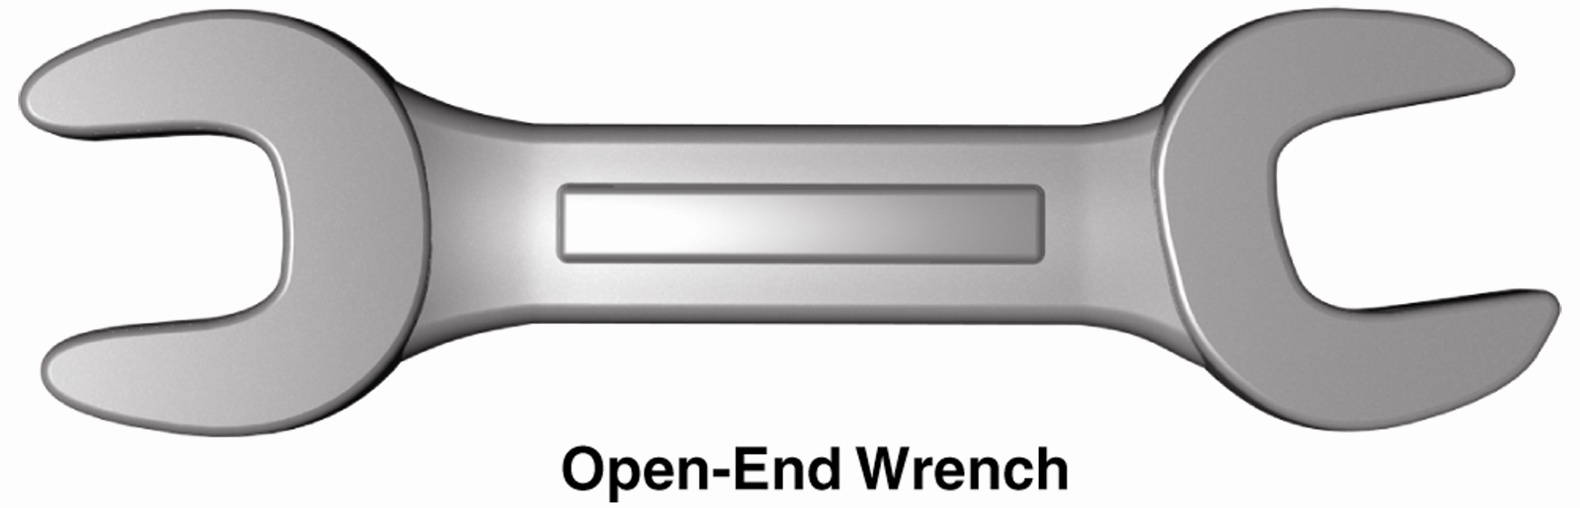
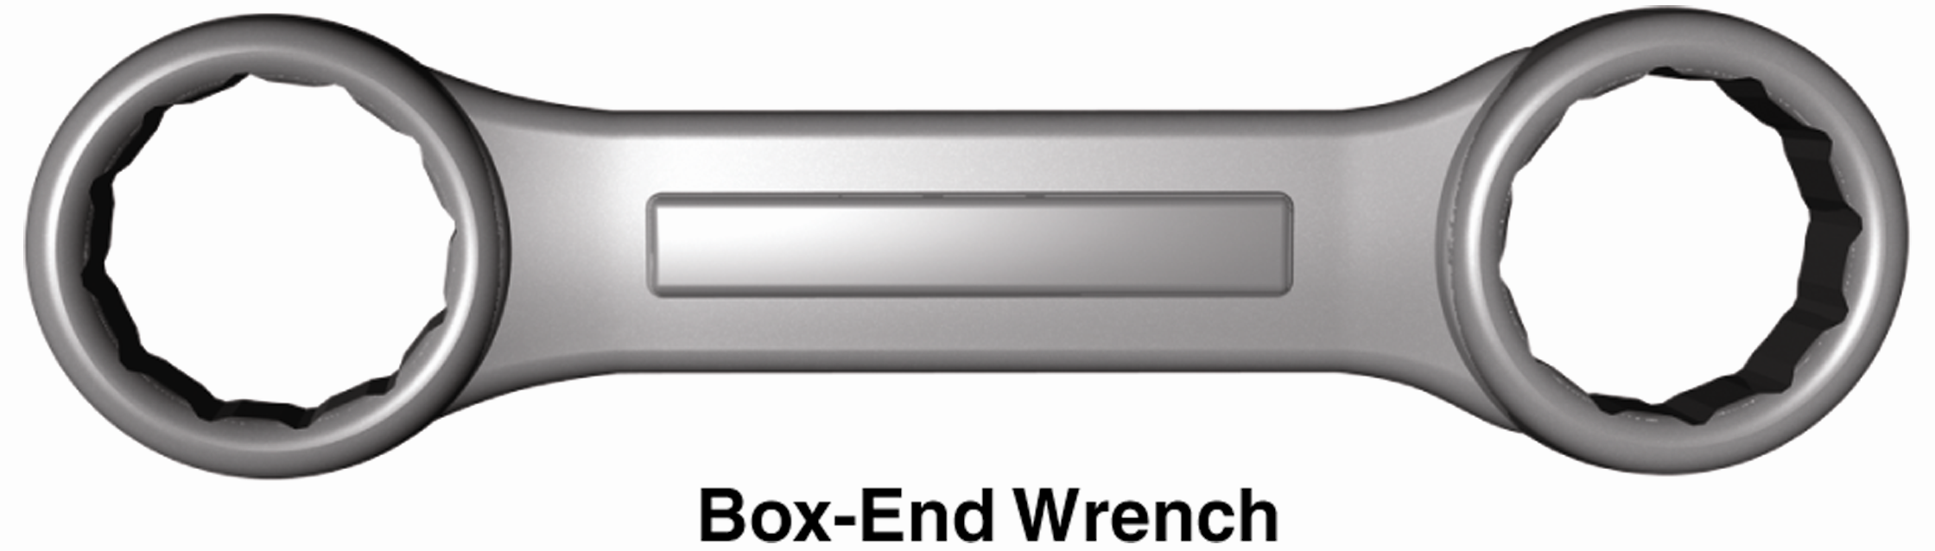
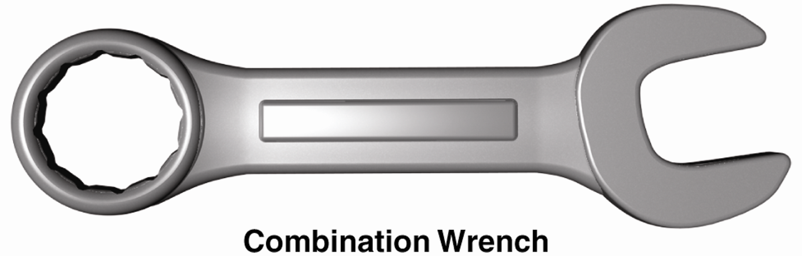
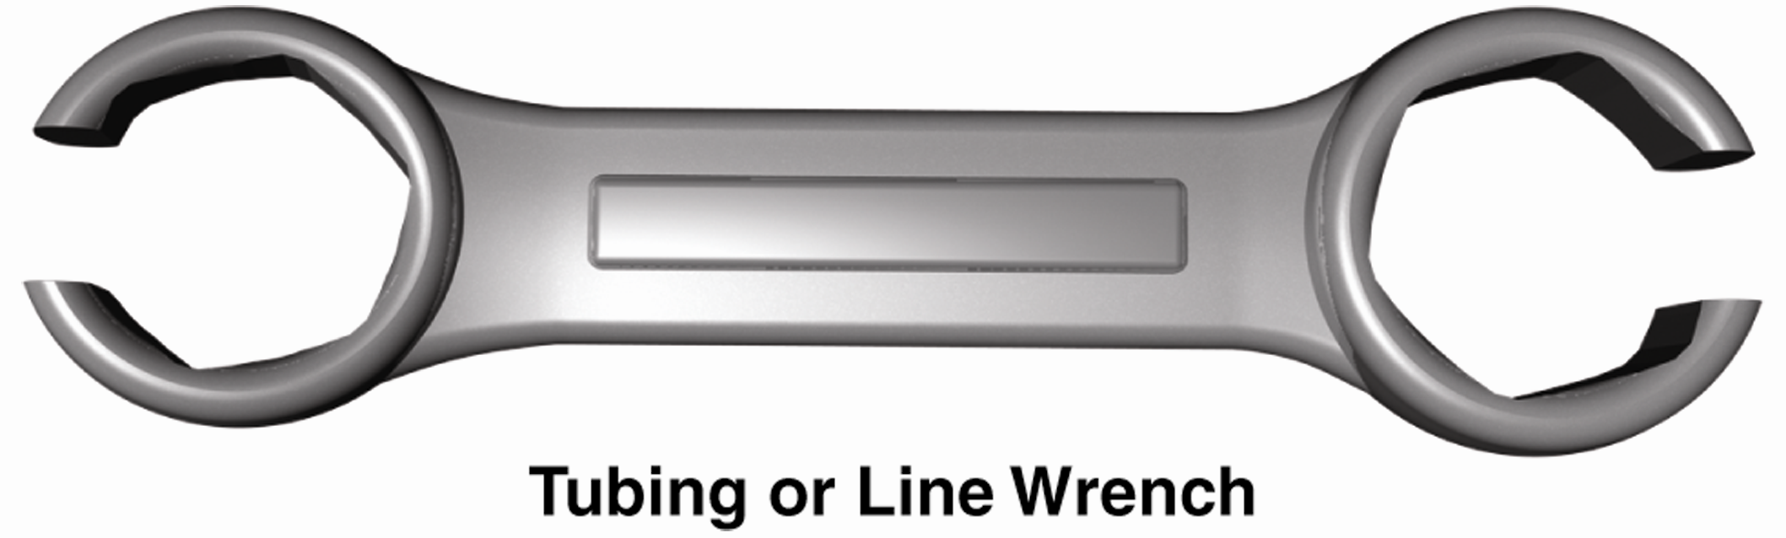
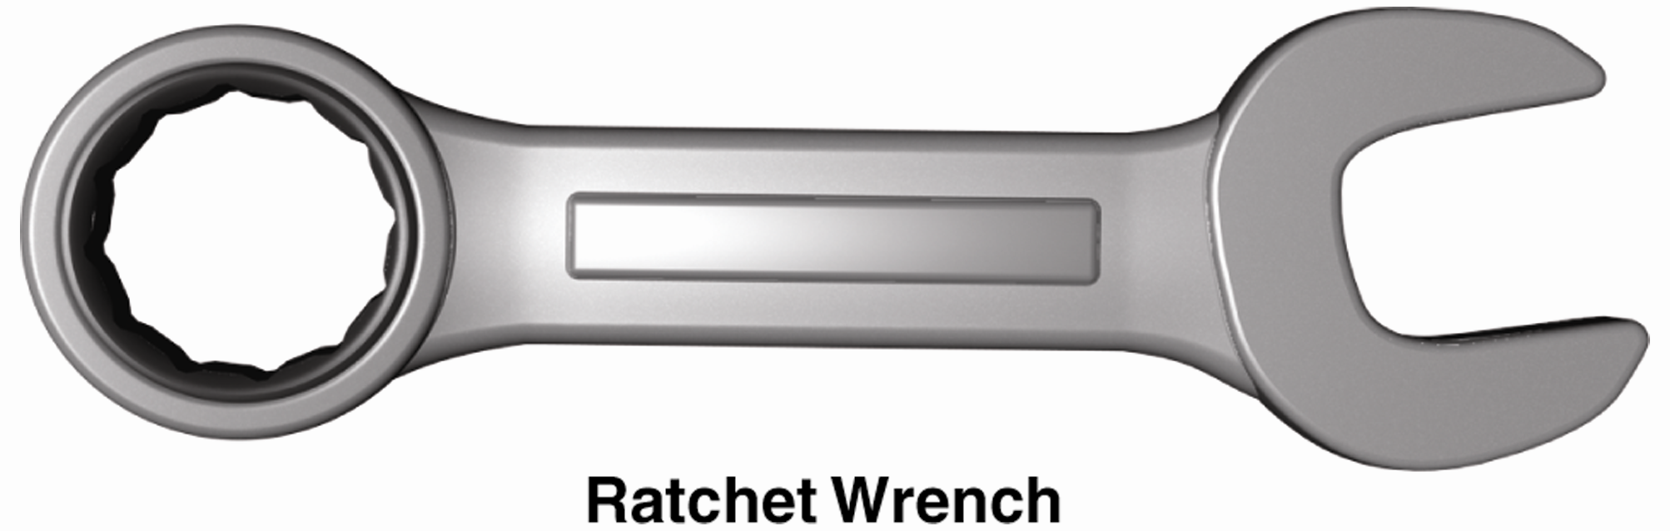
Types of Wrenches
Open-end wrenches
Box-end wrenches
Combination wrenches
Line wrenches
Ratcheting wrenches
Socket wrenches

Slide 10
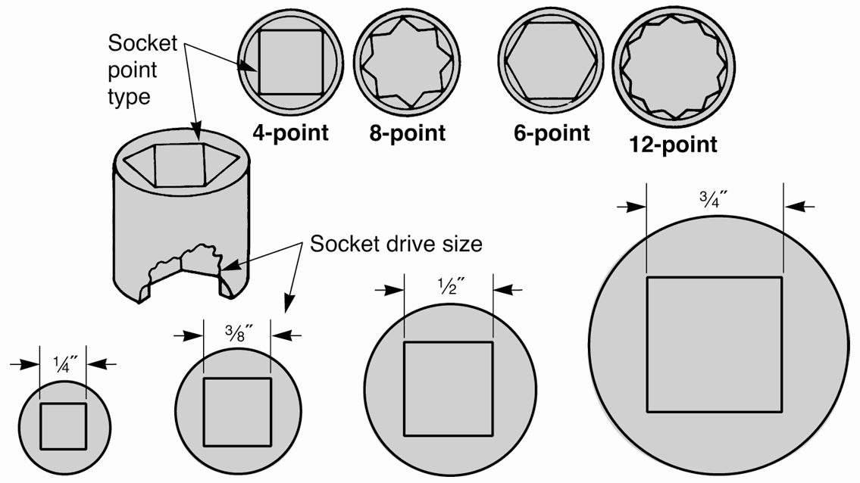
Socket Wrenches
Socket
  Cylinder-shaped
  Remove or install nuts and bolts
  Four drive sizes and four different points

Slide 11
Socket Wrenches (Cont.)
Socket handles
  Fit into square opening in top of socket
Extensions
  Used between socket and its handle
Universal joint
  Swivel that lets socket wrench reach around obstructions

Slide 12
Other Wrench Types
Adjustable wrench or crescent wrench
  Has jaws that adjust to different head sizes
Pipe wrench
  Used to grasp cylindrical objects
Allen wrench
  Hexagonal (six-sided) shaft-type wrench
    Used for set screws on pulleys, gears, and knobs

Slide 13
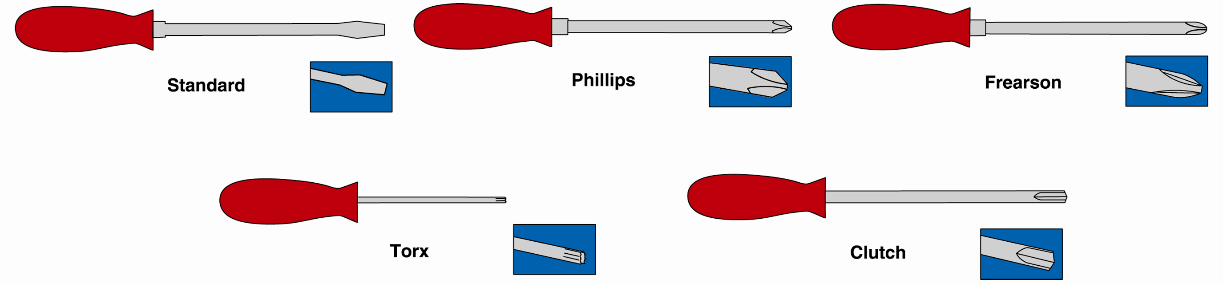
Screwdrivers
Remove or install screws
Come in many shapes and sizes
(Snap-on Tool Corp.)

Slide 14
Screwdrivers (Cont.)
Offset and stubby screwdrivers
  Use in tight places
Starting screwdrivers
  Hold screw until started
Scratch awl
  Has sharp pointed tip
Impact driver
  Used to loosen extremely tight screws

Slide 15
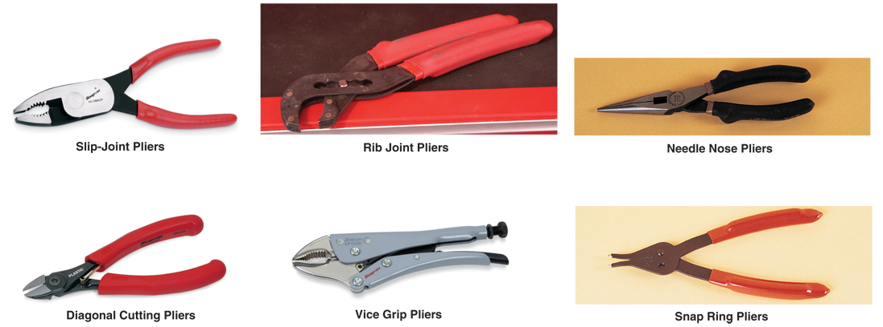
Pliers
Used to grip, cut, crimp, hold, and bend various parts
Various types

Slide 16
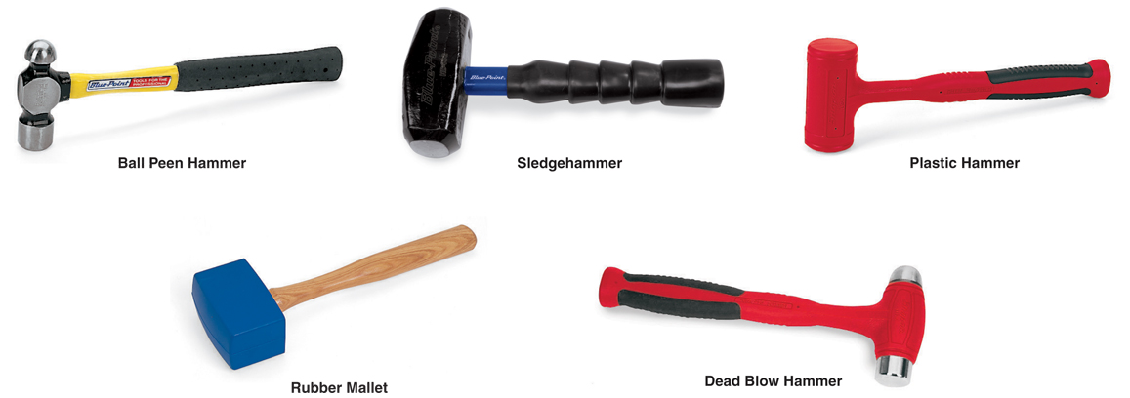
Hammers
Used for operations that involve striking tool or part
Various types

Slide 17
Hammer Safety Rules
Select right size hammer
Always check hammer head is tight on handle
Use brass, plastic, or dead blow hammer on parts that may be damaged using steel hammer
Grasp hammer near end of handle and strike squarely

Slide 18
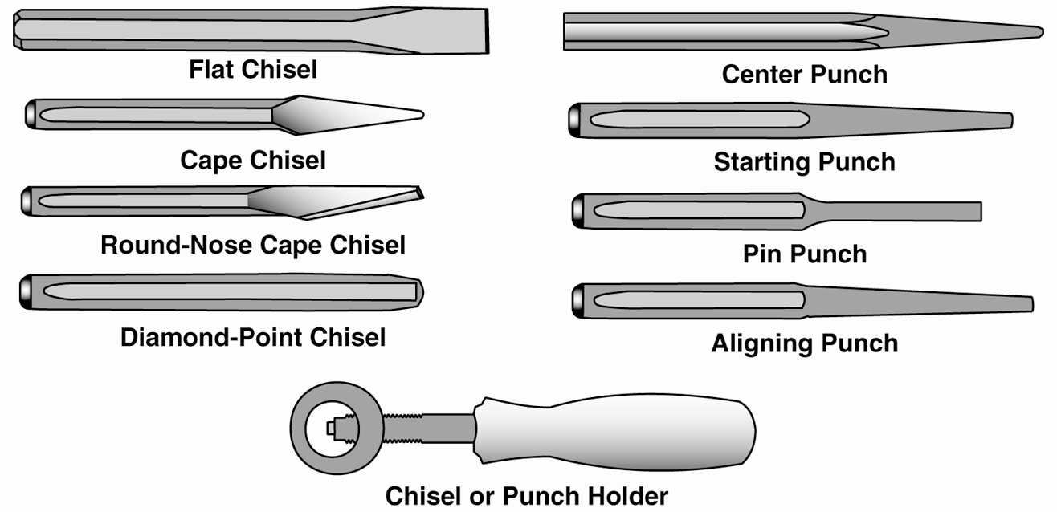
Chisels and Punches
Chisels
  Cut off damaged or rusted nuts, bolts, and rivet heads
Punches
(Snap-on Tool Corp., OTC/SPX Corp., and Proto Tools)

Slide 19
Punch Types
Center punch
  Used to mark parts for reassembly or start hole before drilling
Starting punch or drift punch
  Used to drive pins, shafts, and metal rods partway out of hole
Pin punch
  Used after starting punch to push shaft or rod
Aligning punch
  Used for lining up parts during assembly

Slide 20
Chisel and Punch Safety Rules
Use largest punch or chisel that will work
Keep both ends of punch or chisel properly ground and shaped
Grind off and chamfer mushroomed tool
Grind slowly to avoid overheating
Wear eye protection

Slide 21
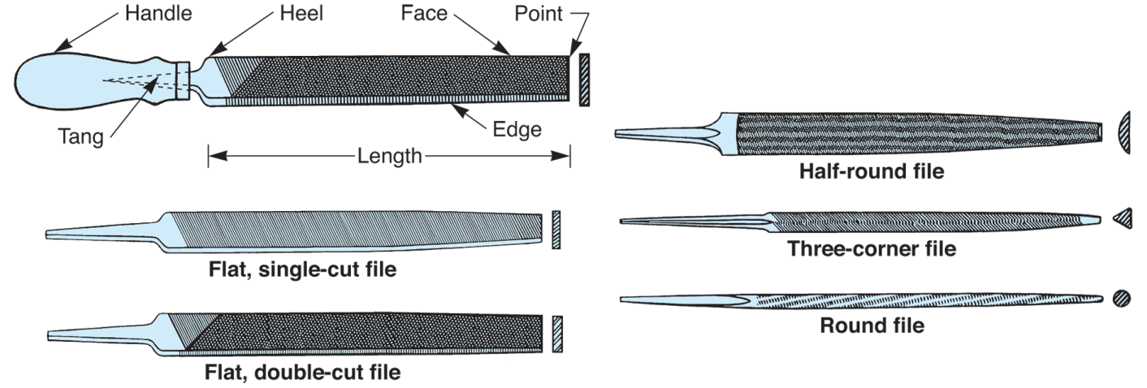
Files
Remove burrs, nicks, sharp edges
Perform other smoothing operations
Classified by length, shape, and cutting surface
(Starrett)

Slide 22
File Safety Rules
Never use file without handle securely attached
Apply pressure only on forward stroke
Place one hand on handle and other on file tip
Do not file too rapidly
Clean clogged file with file card or wire brush
Never hammer or pry with file

Slide 23
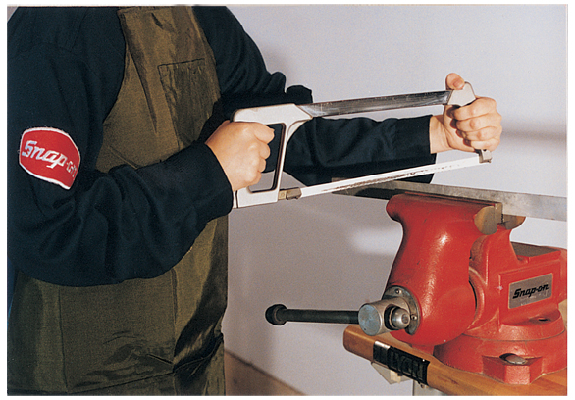
Saws
Hacksaw
  Cut metal
  Select appropriate blade for job
  Teeth should point away from handle
Place one hand on handle and other on end of frame

Slide 24
Holding Tools
Vice
  Holds parts during cutting, drilling, hammering, and pressing operations
Vice caps or wood blocks
  Prevent damage to delicate parts in vice
C-clamp (portable)
  Holds parts to work surface during drilling, filing, cutting, or welding operations

Slide 25
Vice Safety Rules
Never hammer on vice handle
Keep moving parts clean and oiled
Wear safety glasses
Be careful not to damage parts in jaws
Use vice caps

Slide 26
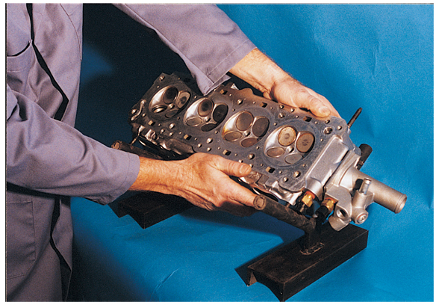
Stands and Holding Fixtures
Used to secure heavy or clumsy parts during repairs
  Cylinder
  head stands
  Transmission
  fixtures
  Rear axle
  holding
  stands

Slide 27
Cleaning Tools
Remove carbon, rust, dirt, grease, old gaskets, and dried oil from parts
  Scrapers
    Remove grease, gaskets, sludge, dried oil, and carbon from flat surfaces
    Wear gloves and watch hands
  Brushes
    Remove light rust, paint, and dirt from irregularly shaped parts

Slide 28
Probe and Pickup Tools
Used when dropped nuts, bolts, or small parts cannot be reached by hand
  Magnetic pickup tool
  Finger pickup tool
  Mirror probe

Slide 29
Cutting Tools
Used to open part boxes
Cut off insulation
Various cutting and scraping tasks

Slide 30
Pry Bars
Strong steel bars
Used for assembly, disassembly, and adjustment operations
  Aligning heavy parts
Use caution while prying

Slide 31
Insulated Tools
Insulate user from electric shock and electrocution
  Frequently used for hybrid electric drive train service
    Only use tools rated for 1000 V
    Available in sets for hybrid vehicle service

Slide 32
Insulated Tools (Cont.)
Insulated wrenches
Electrician’s pliers
High-voltage pliers
Plastic pliers
Graphite and HV screwdrivers

