Slide 1


Slide 2
25
Chapter
Computer System Service

Slide 3
Objectives
After studying this chapter, you will be able to:
Perform a visual inspection of the computer, its sensors, actuators, and the systems they monitor and control.
Test sensors and their circuits.
Remove and replace sensors.
Test and replace actuators.
Remove and replace a computer.

Slide 4
Objectives
Program an EEPROM.
Demonstrate safe working practices when servicing automotive computers.
Correctly answer ASE certification test questions on servicing computer system components.

Slide 5
Computer System Service Introduction
This chapter summarizes
  How to test computer components and circuits
  Develop skills needed to verify where problems are
After checking for trouble codes, you can find the exact problem source by doing pinpoint tests
Pinpoint tests are more specific tests of individual components

Slide 6
Preliminary Visual Inspection
Involves looking for signs of obvious trouble
  Loose wires
  Leaking vacuum hoses
  Part damage

Slide 7
KISS
Helpful acronym for finding performance problems on computer controlled vehicles
KISS stands for “keep it simple, stupid”
Means start troubleshooting with simple checks and tests

Slide 8
Electrical Component Damage
Things to remember for semiconductor devices and their wiring
When welding, disconnect battery ground and disarm airbag system
Never disconnect battery cables with engine running

Slide 9
Electrical Component Damage (Cont.)
Do not disconnect or connect wiring, especially computer wiring, with ignition key on
Make sure you do not reverse battery cable connections
Wear anti-static wrist strap when handling static-sensitive components

Slide 10
Electrical Component Damage (Cont.)
Use only high-impedance test lights and meters when checking electronic circuits or wiring
Do not disconnect a scan tool from data link connector with ignition key on

Slide 11
Computer System Circuit Problems
Basic circuit problem
  Caused by problem in circuit increasing or decreasing current, resistance, or voltage
Almost all electrical-electronic problems are actually basic circuit problems

Slide 12
Locating Computer Problems
Ask yourself
What could be causing specific symptoms?
How many components are affected?
Is problem always present or is it intermittent?
Is problem’s occurrence related to heat or cold?
Is problem’s occurrence affected by moisture?

Slide 13
Stress Testing
Use of heat, cold, or moisture to simulate extreme operating conditions of components

Slide 14
Sensor and Actuator Problems
Scan tool used to find problem circuits and components
Use digital multimeter to test specific components
Compare test results to factory specifications
If test value too high or too low, sensor or actuator is faulty and must be replaced

Slide 15
Wiring Diagrams
Wiring diagram or schematics
  Show color codes of wires and number of connectors used to feed signals from sensors to computer and out to actuators

Slide 16
Poor Electrical Connections
Most common cause of electrical-related problems in a computer system
Wiggle test finds poor connections and intermittent problems
OBD II scan tools help find poor electrical connections

Slide 17
Vacuum Leaks
Frequently caused by deteriorated, broken, or loose vacuum hoses
Often make hissing sound
Can upset computer system operation and cause range of symptoms
Some engine sensors and actuators rely on engine vacuum for operation

Slide 18
Sensor Service
Involves testing and, if needed, replacing computer system sensors
For testing purposes, classify sensors into one of two categories
  Passive sensors
  Active sensors

Slide 19
Passive Sensors
Passive sensors do not generate own voltage
  Computer must feed them reference voltage
Passive sensors change internal resistance with change in system or vehicle condition or operation
  This modifies reference voltage, which computer interprets and uses to control various systems

Slide 20
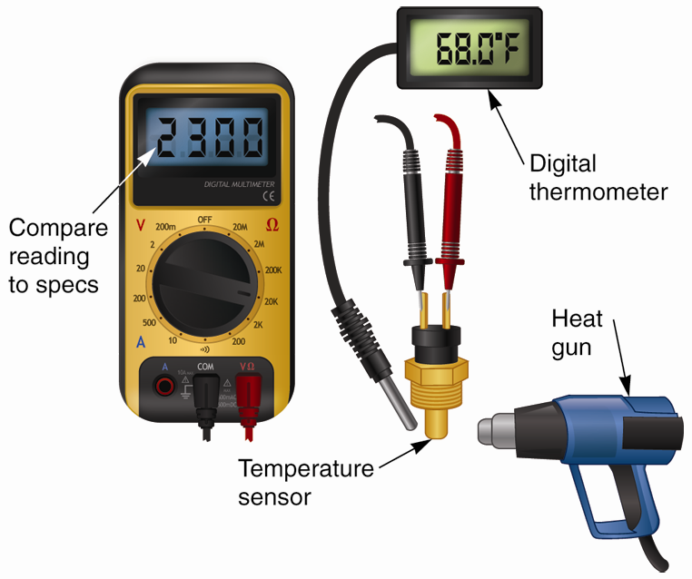
Testing Passive Sensors
To test variable resistance sensor with ohmmeter
Disconnect sensor wires
Connect test leads to sensor terminals
Compare reading to manufacturer’s specifications

Slide 21
Testing Passive Sensors (Cont.)
To check variable resistance sensor with voltmeter
Connect voltmeter in parallel with sensor
  Be sure to leave computer wires connected to sensor
Measure voltage drop across sensor with computer reference voltage applied
Compare measurements to specifications

Slide 22
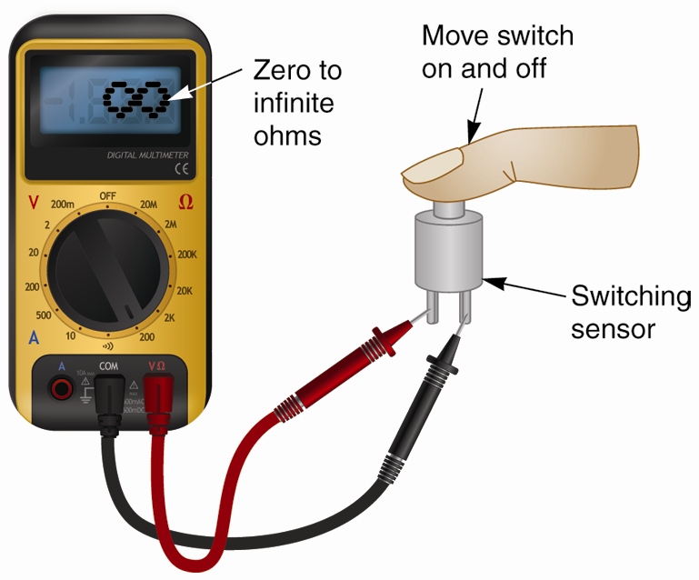
Testing Switching Sensors
Use ohmmeter to check that switch is opening and closing
Meter should register infinite ohms and then zero ohms

Slide 23
Testing Reference Voltage
To measure reference voltage to passive sensor
  Disconnect wires leading to sensor
  Connect digital voltmeter to wires
  Turn ignition key on and note your readings
  Compare voltage readings to specifications
    Open circuit voltage should be about 5 volts

Slide 24
Active Sensors
Active sensor produces its voltage and sends it back to computer
Voltage produced by active sensor is very low, often under 1 volt
One poor electrical connection can keep low voltage from returning

Slide 25
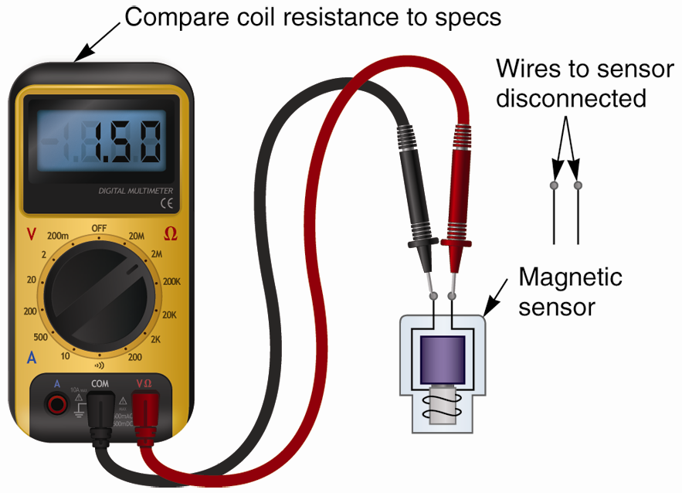
Testing Active Sensors
Ohmmeter connected to common magnetic sensor
Ohmmeter will measure resistance of coil winding
Replace sensor if resistance is high or low

Slide 26
Testing Active Sensors (Cont.)
Ac voltmeter connected to magnetic sensor
Trigger wheel must be rotated to generate voltage
Should produce about 1.5–3 volts ac
Magnet can be passed by coil to make it produce voltage

Slide 27
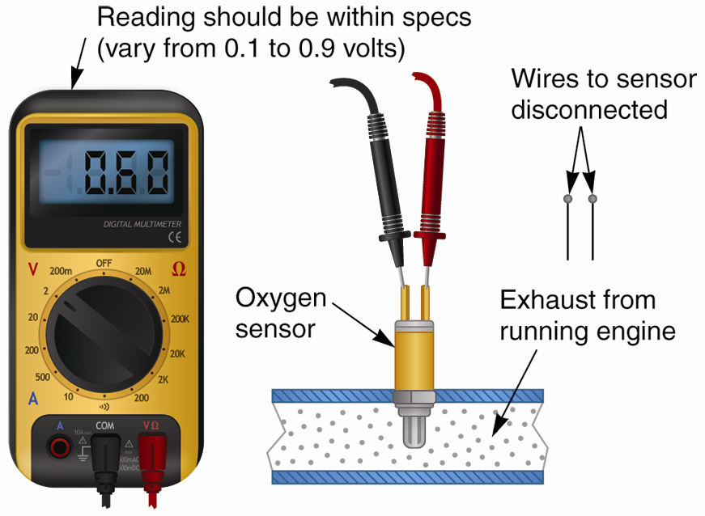
Testing Active Sensors (Cont.)
Voltmeter connected to oxygen sensor
With engine running in closed loop, voltmeter should show sensor’s output voltage
If output voltage low or high, sensor may require replacement

Slide 28
Replacing Sensors
Always purchase exact sensor replacement
Release sensor connector properly
Use special tools as needed
Some sensors, such as oxygen sensors, require use of sensor socket
  Socket with deep pocket and cutout fitting over sensor and any wires
Use thread sealant sparingly

Slide 29
Replacing Sensors (Cont.)
Use thread and engine sealants safe for oxygen sensors
Tighten sensor properly
Adjust sensor, if needed
Scan for trouble codes after sensor replacement

Slide 30
Actuator Service
Actuator service
  Involves testing actuators for possible problems and replacing them, if necessary
Testing actuators
  Actuators are simply relays, solenoids, and motors, and easy to test

Slide 31
Testing Servo Motors
Voltage source has been connected
Wiring harness has been disconnected
Jumper wires feed current directly to the motor

Slide 32
Testing Solenoids
When jumper wires connect to vehicle’s battery and solenoid, solenoid should operate
Ohmmeter can also be used to test solenoid

Slide 33
Testing Relays
Check voltage entering relay and voltage leaving relay
Possible that voltage is applied to relay, but relay points are not sending voltage to controlled device

Slide 34
Relays
Relays are almost anywhere on vehicle
  In engine compartment
  Under dash
  Under seat
  In trunk
Junction block
  Encloses most or all of vehicle’s mechanical relays in single housing

Slide 35
Replacing Actuators
Do not damage wire connectors when releasing them
Do not drop mounting screws during removal or installation
Make sure you have correct replacement actuator before installation
Check that actuator is fully seated before tightening
Double-check actuator operation after replacement

Slide 36
Computer Service
Involves replacing or reprogramming the computer
Computer is last component to be suspected of being problem source

Slide 37
Measuring Computer Output
Defective computer often identified through process of elimination
Computer output
  Can be reference voltage to sensor or supply voltage to actuator
Most computers produce reference voltage of about 5 volts
  If reference voltage not correct, check wiring before condemning computer

Slide 38
Measuring Computer Output
Every input and output passes through individual metal terminal, or pin, which plugs into wiring harness
Pin numbers identify location and purpose of each terminal in computer wiring harness connector
Probe computer terminal pins to find source of complex problems

Slide 39
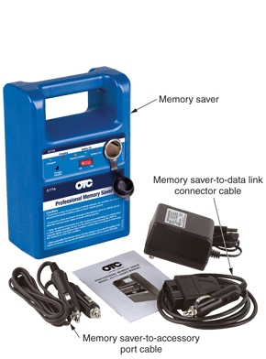
Saving Memory
Memory saver
  Supplies enough power to keep clock, stereo, and computer from losing stored information
(OTC/SPX Corp.)

Slide 40
Computer Replacement
Before disconnecting battery and removing computer, scan computer and obtain PROM identification number or EEPROM calibration number
  Needed to check for updated PROMs
  External identification numbers not always placed on PROM

Slide 41
Computer Replacement (Cont.)
When removing a computer
  Ignition key should be off
  Vehicle’s negative battery cable should be disconnected
Remove shields or components necessary to access the computer
Unbolt brackets holding computer in place
Unplug computer connectors

Slide 42
EEPROM Programming Using Computerized Equipment
Most newer computers use
EEPROM
  Electrically Erasable Programmable Read Only Memory
FEPROM
  Flash Erasable Programmable Read Only Memory
EEPROMs programmed using method referred to as flash programming

Slide 43
EEPROM Direct Programming
Direct programming uses service computer or laptop
Fastest and simplest method
New information downloaded by attaching shop recalibration device directly to data link connector

Slide 44
EEPROM Remote Programming
Remote programming done with vehicle’s computer removed
Used when changes must be made through direct modem connection to manufacturer’s database
Can also be done in cases where direct programming is not practical or possible

Slide 45
EEPROM Programming Procedure
Make sure vehicle’s battery is fully charged
Connect programming computer or scan tool to data link connector
  Make any other connections as needed
Enter vehicle information as prompted
Go to programming software and follow directions

Slide 46
Programming a New Computer
If installing new computer, program only that computer
Be careful not to program the wrong computer
Do not attempt to program it with information from old computer or computer from another vehicle

Slide 47
Reprogramming Computers
Computer reprogramming often needed to solve specific performance or emission related problems
Manufacturers will put out a bulletin and provide modified software
Before reprogramming, determine current programming date
If current program is latest version, no further action required

Slide 48
Computer Relearn Procedures
After being serviced, computer system may have to go through relearn procedure
  Period where computer system adapts to new components and programming information
Computer must receive inputs to formulate adaptive strategies to set some output parameters

